Slide 1

AI and Machine Learning for IoT Big Data

Slide 2
First steps with BD

Slide 3
Outline of the lecture
As a preparation to working with BD, we review some concepts from statistics.
Although with BD we hope to catch new insights, before that we need to understand the elementary concepts of extracting numerical indicators from data, like descriptive statistics and hypothesis testing.

Slide 4
Outline of the lecture
It is essential to understand the proper use of statistical indicators, what insight they give into the data, and what are their limitations.
We review some common mistakes with statistics, and consider how to avoid them.

Slide 5
Where are we in the Course?
Introduction: Background of IoT, Big Data, AI
Collect, analyze data from IoT on a large scale
Elements and practice of statistics
AI methods for data science
Getting further with AI: internal workings
Practical usage of AI for Big Data from IoT
Moving into the real world

Slide 6
Lecture 3: Big Data analysis
Statistical foundations
Descriptive statistics
Pitfalls of descriptive statistics
Hypothesis testing for detection
Regression for prediction
Statistic for BD (Big Data)
Some BD platforms

Slide 7
Foundations of Statistics
Data is a representative sample
Parameters calculated from the data help us understand it
Correct selection maximizes the probability of correct decision

Slide 8
Foundations of BD Statistics
Data is a representative sample
Parameters calculated from the data help us understand it
Correct selection maximizes the probability of correct decision
Big Data contains some representative samples
Information extracted from the data helps us understand it
Discovery of crucial parameters maximizes the probability of correct decision
Notes:
BD is often messy, contaminated with noise, needs cleanup and selection
Might require multiple domain knowledge (e.g. medical + engineering + social etc.)
The interesting information needs to be mined out, not obvious
But some tools are common with classical statistical analysis!

Slide 9
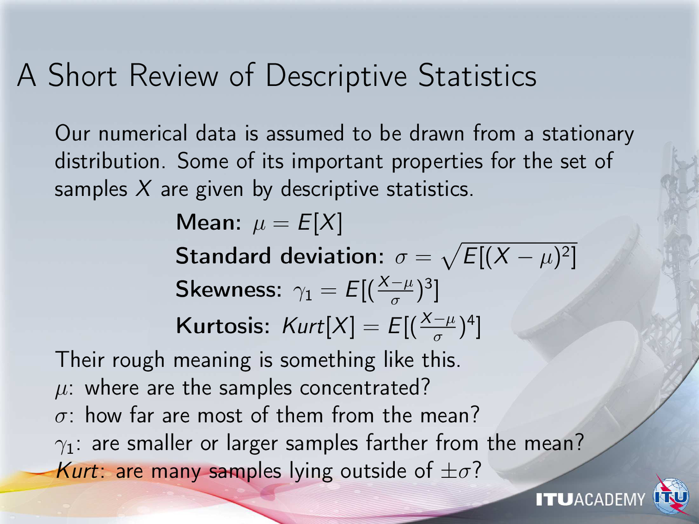
Notes:
These numbers are calculated by Python functions, no need for coding

Slide 10
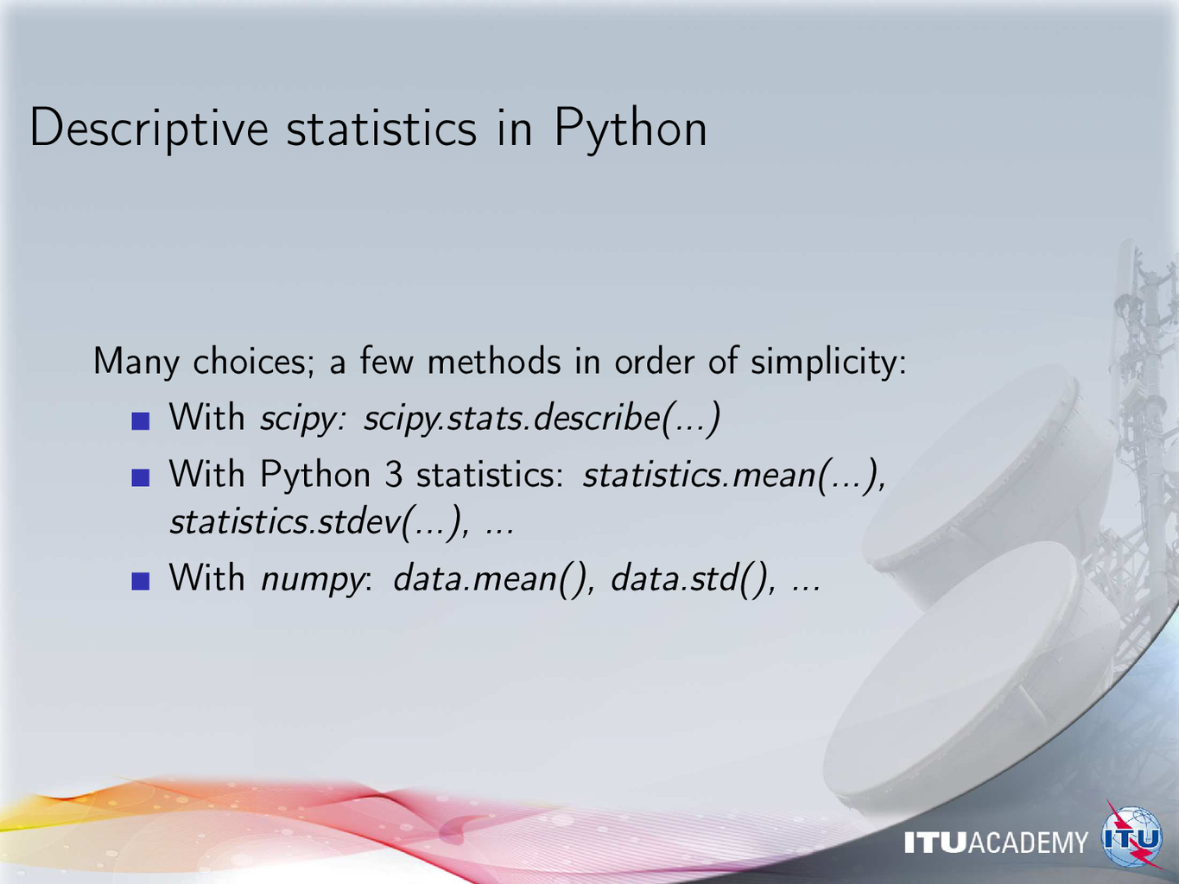
Notes:
Scipy now contains basically all of Numpy and many things not in Numpy, but for historical reasons we still tend to use Numpy.
Although Numpy could in principle replaced with Scipy, it does not seem to happen…
Similar functionalities are available in many other forms, mention the importance of getting
familiar with the R language for serious involvement in statistics.
Other excellent but not free platforms include Mathematica ® and MATLAB ®

Slide 11
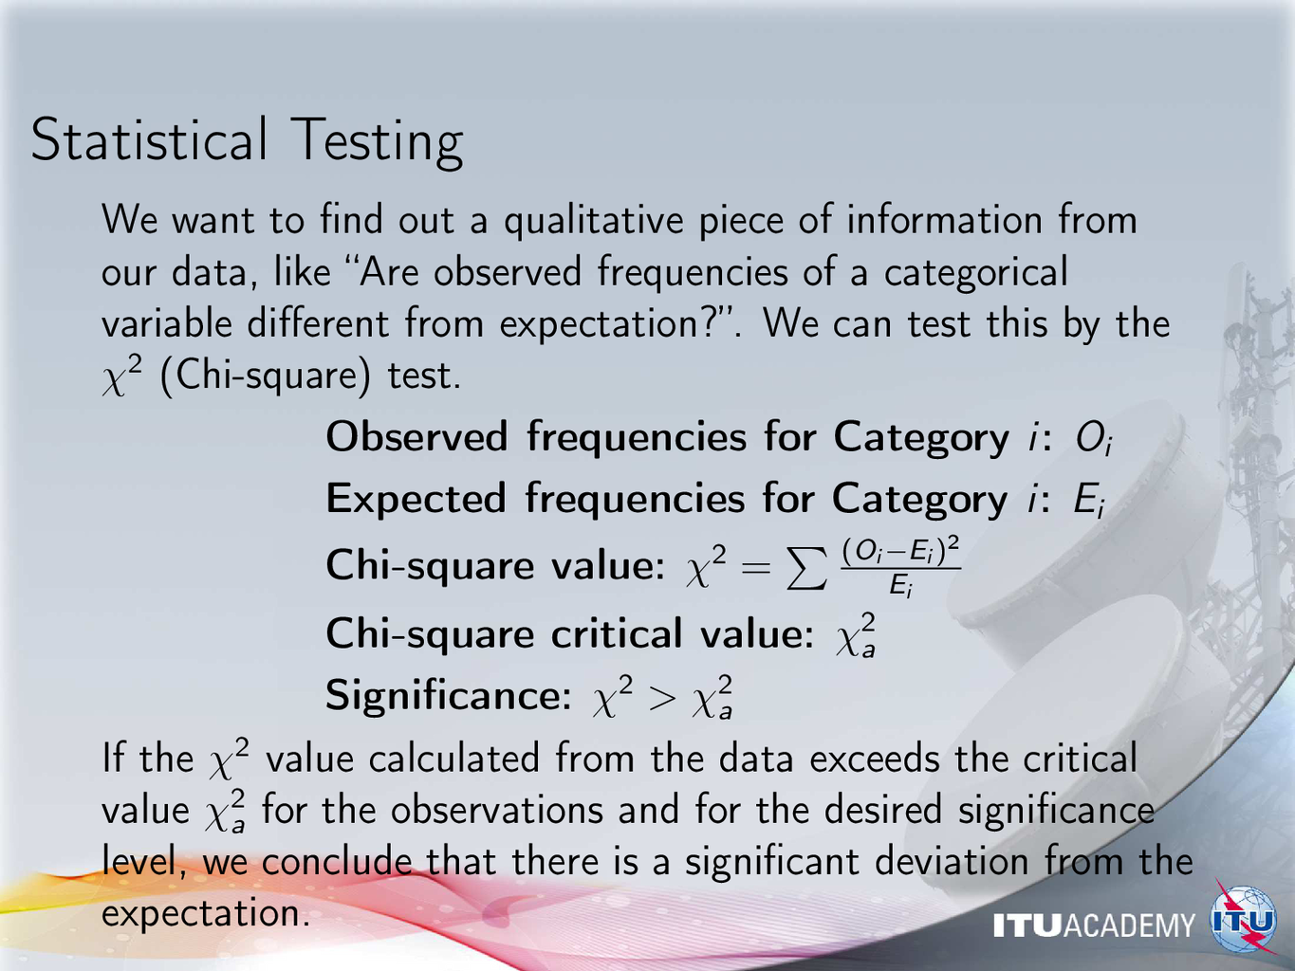
Notes:
Present examples from everyday life:
proportion of female vs. male persons in: students, faculty, doctors, politicians, as compared to demographics
other human distributions: age groups, education, etc.
Consider implications to IoT data analysis

Slide 12
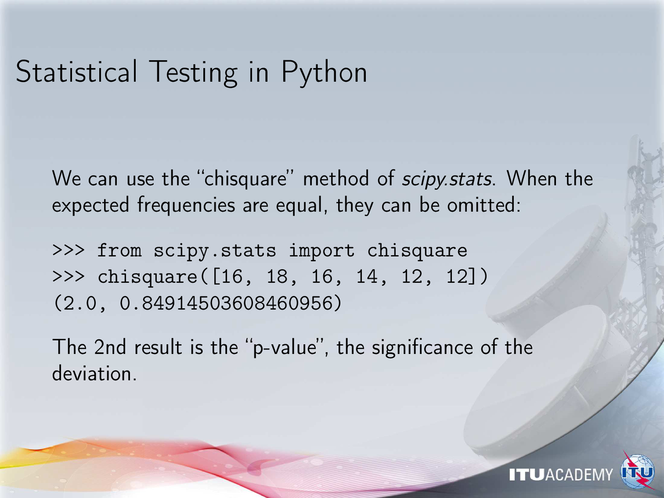
Notes:
Remind the audience about experimenting with the notebooks
This p-value is much larger than 5% - explain the meaning: no surprise here, we see expected small deviations only.

Slide 13
Some numerical examples
How surprising is the distribution?
>>> chisquare([16,18,16,12,12,12])
Power_divergenceResult(statistic=2.4651162790697674, pvalue=0.7817392196814593)
>>> chisquare([16,18,12,12,12,12])
Power_divergenceResult(statistic=2.585365853658537, pvalue=0.7635874800646456)
>>> chisquare([16,12,12,12,12,12])
Power_divergenceResult(statistic=1.0526315789473681, pvalue=0.9582099520168099)
>>> chisquare([12,12,12,12,12,12])
Power_divergenceResult(statistic=0.0, pvalue=1.0)
If all samples are identical, there is no surprise
Notes:
pvalues show the probability of getting the result in case of the Null Hypothesis.
When pvalue == 1.0, we are almost certain that the Null Hypothesis is correct, “there is nothing interesting going on here”.

Slide 14
Some numerical examples
What if there is an outlier?
>>> chisquare([16,18,16,14,12,0])
Power_divergenceResult(statistic=16.842105263157897, pvalue=0.004809190778472782)
This case is unexpected, we should conclude that the null hypothesis of random distribution is not supported
There are many other hypothesis tests, depending on the problem
Notes:
pvalue << 0.05: usually we consider the result to be significant in this case.
Something seems to be going on here…

Slide 15
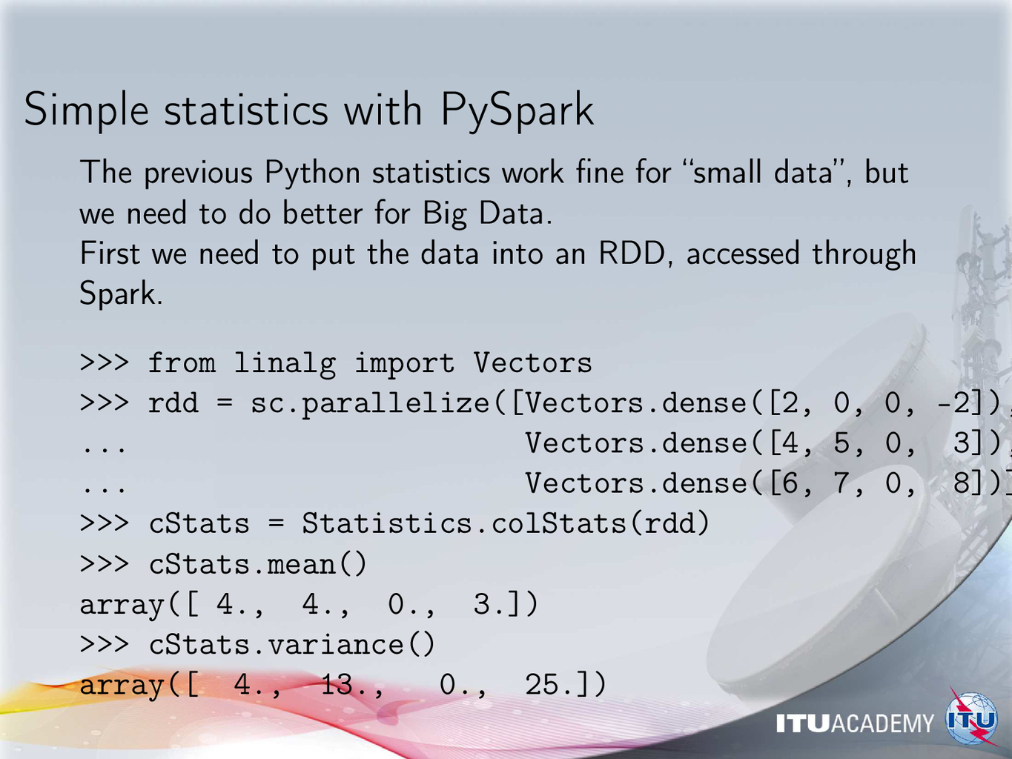
Notes:
Review some Big Data concepts like distributed storage and processing

Slide 16
Some warnings from statistics
Facts are stubborn, but statistics are more pliable.
Mark Twain
Read more at: https://www.brainyquote.com/quotes/mark_twain_163414

Slide 17
Descriptive statistics…
We have found these parameters for our data:
Property | Value
Mean of x | 9
Sample variance of x | 11
Mean of y | 7.50
Sample variance of y | 4.125
Correlation between x and y | 0.816
Linear regression line | y = 3.00 + 0.500x
source: https://en.wikipedia.org/wiki/Anscombe's_quartet
Notes:
Warn the audience about looking only at the numbers
Statistics don’t tell everything about the data
In some cases they can be misleading without an understanding of their origin

Slide 18
Four very different datasets - which one did we use?
The scatter? The curve? The outlier? The singlet?
https://commons.wikimedia.org/w/index.php?curid=9838454
Anscombe, Francis J. (1973) Graphs in statistical analysis. American Statistician, 27, 17–21.
Notes:
The previous descriptive statistics are common to all of the four datasets!

Slide 19
Careful with descriptive statistics
The accuracy of parameters for each data:
Property | Value | Accuracy
Mean of x | 9 | exact
Sample variance of x | 11 | exact
Mean of y | 7.50 | to 2 decimal places
Sample variance of y | 4.125 | plus/minus 0.003
Correlation between x and y | 0.816 | to 3 decimal places
Linear regression line | y = 3.00 + 0.500x | to 2 and 3 decimal places, respectively
Notes:
Each dataset has the same parameters to high accuracy
However, they have totally different structure, which cannot be seen in the numbers
We MUST try to visualize the data before jumping to conclusions!

Slide 20
Some more pitfalls
Consider:
errors (noise in measurement)
blunders (mistakes in procedure)
lies (intentional falsehoods)
Big Data helps in one aspect - which one?
Warning by statisticians: the “N - p fallacy” N: independent observations p: repeated observations too often, BD has big “p” but tiny “N”!
Notes:
Emphasis on the importance for IoT data:
data points in the time series from each sensor are NOT independent,
data from distributed sensors closely located to each other is NOT independent,
sensors are manufactured in batches with non-independent characteristics,
and so on…
Before drawing conclusions, consider the underlying processes!

Slide 21
Pseudo-Replication
The term pseudoreplication was coined by Hurlbert to refer to "the use of inferential statistics to test for treatment effects with data from experiments where either treatments are not replicated (though samples may be) or replicates are not statistically independent."¹ The context of his paper was ecological field experiments, but pseudoreplication can occur in other contexts as well.
Here, replication refers to having more than one experimental (or observational) unit with the same treatment. Each unit with the same treatment is called a replicate.
Heffner et al distinguish a pseudoreplicate from a true replicate, which they characterize as "the smallest experimental unit to which a treatment is independently applied."
https://www.ma.utexas.edu/users/mks/statmistakes/StatisticsMistakes.html
Notes:
Ask students to study the linked site for the many important warnings and advices

Slide 22
Pseudo-Replication
Most models for statistical inference require true replication. True replication permits the estimation of variability within a treatment. Without estimating variability within treatments, it is impossible to do statistical inference. Consider, for example, comparing two drugs by trying drug A on person 1 and drug B on person 2. Drugs typically have different effects in different people. So this simple experiment will give us no information about generalizing to people other than the two involved. But if we try each drug on several people, then we can obtain some information about the variability of each drug, and use statistical inference to gain some information on whether or not one drug might be more effective than the other on average.
True replicates are often confused with repeated measures or with pseudoreplicates. The following illustrate some of the ways this can occur.
https://www.ma.utexas.edu/users/mks/statmistakes/StatisticsMistakes.html
Notes:
Ask students to come up with a similar example for IoT.
We are interested in the effect of automatic irrigation on crop yield.
Field A is in the valley, near to farmhouses, irrigation is controlled manually.
Field B is behind the hill, 50 minutes walk, too far to watch; it is equipped with moisture sensors and automatic pumps.
At the harvest, the yield of Field B is 15% higher than Field A.
How about water consumption, equipment cost, etc. etc.?
Your conclusion?

Slide 23
Examples for pseudo-replication
1. Suppose a blood-pressure lowering drug is administered to a patient, then the patient's blood pressure is measured twice. This is a repeated measure, not a replication. It can give information about the uncertainty in the measurement process, but not about the variability in the effect of the drug. On the other hand, if the drug were administered to two patients, and each patient's blood pressure was measured once, we can say the treatment has been replicated, and the replication may give some information about the variability in the effect of the drug.
https://www.ma.utexas.edu/users/mks/statmistakes/StatisticsMistakes.html
Notes:
When do we want repeated measures?
Suppose there are no seasonal differences, conditions are constant.
Why would we want to get several data points from the same device?

Slide 24
Examples for pseudo-replication
2. A researcher is studying the effect on plant growth of different concentrations of CO2 in the air. He needs to grow the plants in a growth chamber so that the CO2 concentration can be controlled. He has access to only two growth chambers, but each one will hold five plants. However, since the five plants in each chamber share whatever conditions are in that chamber besides the CO2 concentration, and in fact may also influence each other, they are not independent replicates but are pseudoreplicates. The growth chambers are the experimental units; the treatments are applied to the growth chambers, not to the plant independently.
https://www.ma.utexas.edu/users/mks/statmistakes/StatisticsMistakes.html
Notes:
Discuss how similar cautions apply to IoT data collection in different fields:
agriculture
transportation
power distribution
tele-medicine

Slide 25
Working with Big Data

Slide 26
Some Major Platforms
Amazon AWS (Amazon Web Services)
Google Cloud
IBM Infosphere
Cloudera
Microsoft Azure
Notes:
Things change fast, this is current at the time of writing but please update it!

Slide 27
Amazon AWS
Hadoop data clusters
Apache Spark over Hadoop
Native language: Scala (Java-based functional-oriented high-performance language)
Supports Python (PySpark), many others
1 year free trial available
Notes:
Introduce AWS during exercise sessions

Slide 28
Google Cloud
Huge number of datasets for learning
Home of TensorFlow, the Python-based AI framework
Excellent tutorials, documentation
USD 300.00 worth of credit freely available
Notes:
Introduce Google Cloud during exercise sessions

Slide 29
Further study
Students interested in more information about statistical inference are referred to the free book: Computer Age Statistical Inference: Algorithms, Evidence and Data Science, by Bradley Efron and Trevor Hastie
Some highlights: classical inferential theories, survival analysis, logistic regression, empirical Bayes, the jackknife and bootstrap, random forests, neural networks, Markov chain Monte Carlo, inference after model selection
https://web.stanford.edu/~hastie/CASI/

Slide 30
Further reading
Inference https://www.scientificamerican.com/article/the-mind-reading-salmon/a
Common mistakes https://www.ma.utexas.edu/users/mks/statmistakes/StatisticsMistakes.html
Notes:
p-values: problem with finding “significance” anywhere when trying hard enough
http://blogs.oii.ox.ac.uk/policy/many-of-us-scientists-dont-understand-p-values-and-thats-a-problem/
Problems with Null Hypothesis Significance Testing in the context of Big Data:
https://www.frontiersin.org/articles/10.3389/fphy.2016.00006/full

Slide 31
Assignment
Sign up for the free trial of Amazon AWS or Google Cloud
Follow the site introductory documents to set up an instance of a computing cluster
Select an example from the freely available datasets on the site
Follow the tutorials to execute a simple Big Data processing task. Note the problems!

Slide 32
Summary of the lecture
We have reviewed the elements of descriptive statistics, and how to get such information on a BD platform with Python or Scala.
We have also looked into some common pitfalls: blind reliance on statistical indicators while losing track of the actual data; mistakes in the experimental design of the data process; and misunderstandings about replication that invalidate hypothesis testings.

